Slide 1
Cryogenic Material Library – An Overview
Henry Nachman
07 August 2024
CMB-S4 Technical Meeting

Slide 2
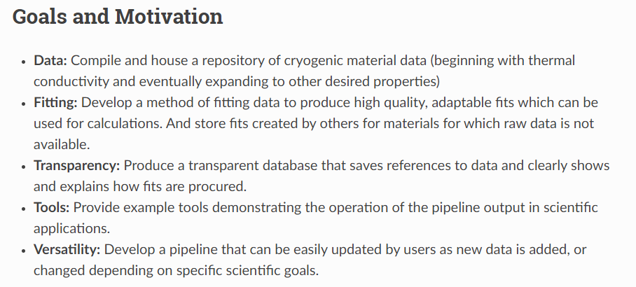

Slide 3
What does this repo have?

Slide 4
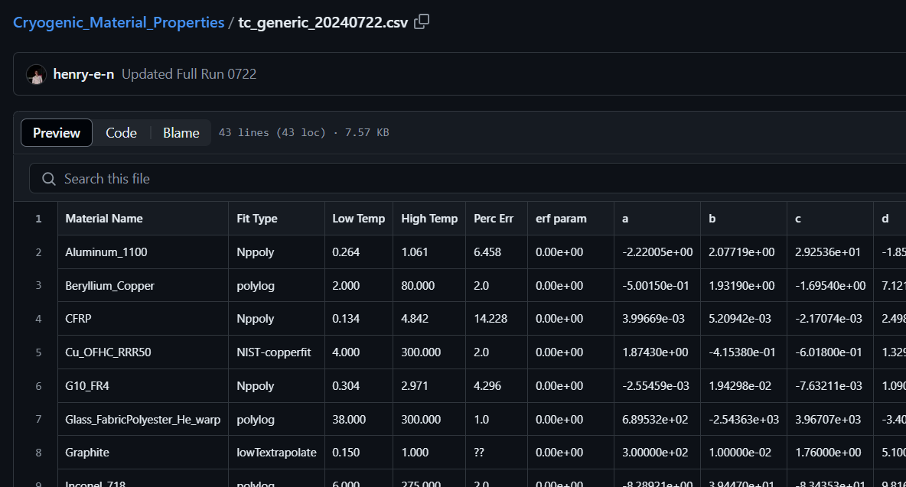
Material Name
Fit Parameters
(between 3 and 10+)
Range of Fit
Fit Type Flag

Slide 5
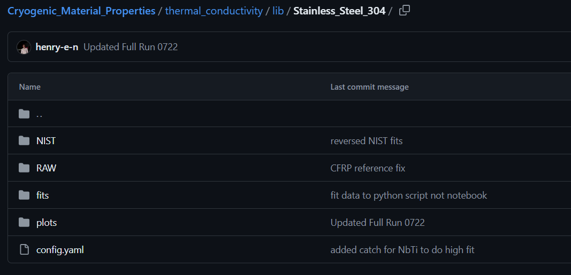
Fit pulled from NIST website
Raw thermal conductivity data (if available)
In-house fits (from raw data)
A config file with some necessary info like ‘parent’ materials, and data flags.

Slide 6
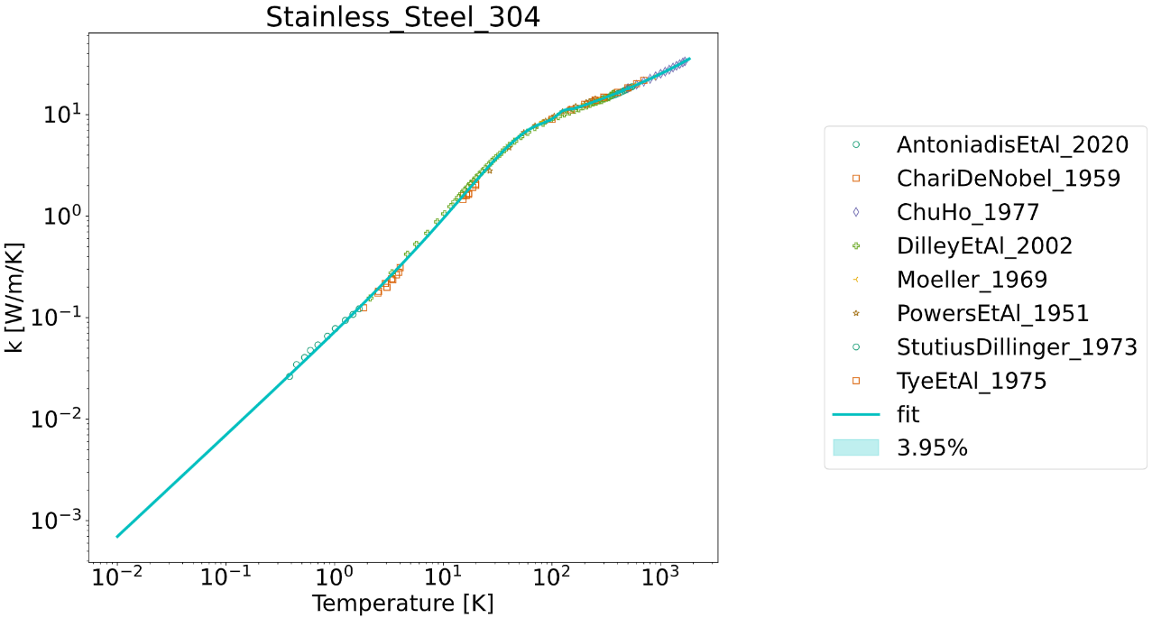

Slide 7
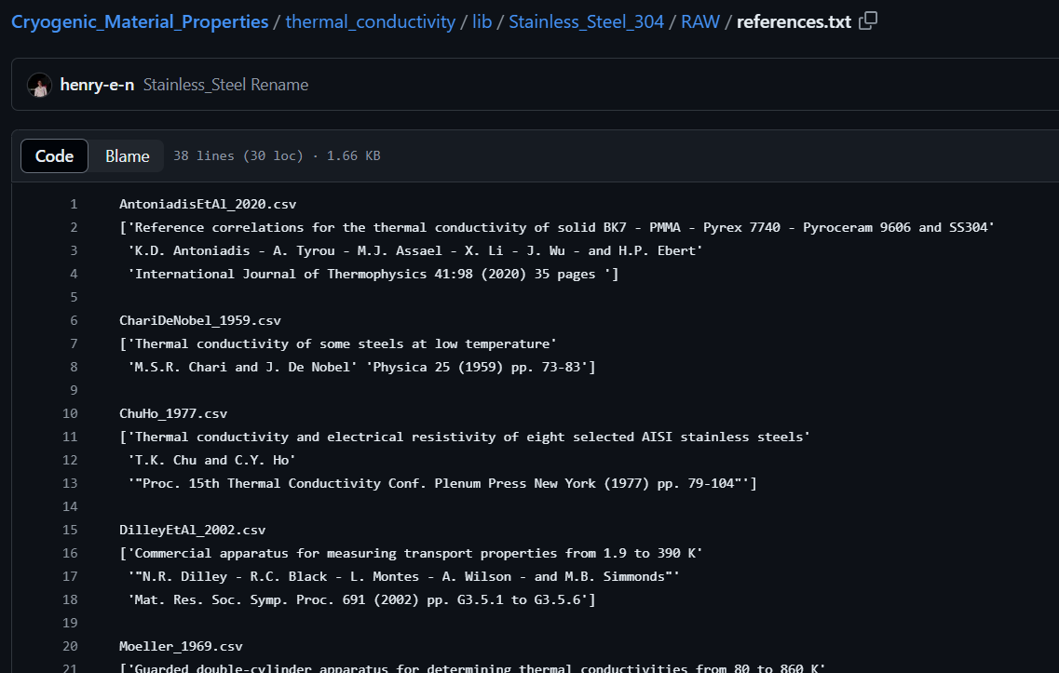

Slide 8
How can you use this repository?

Slide 9
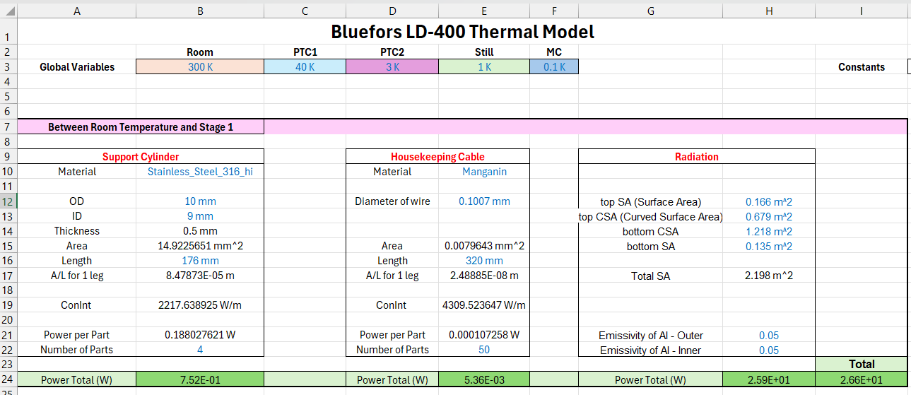

Slide 10
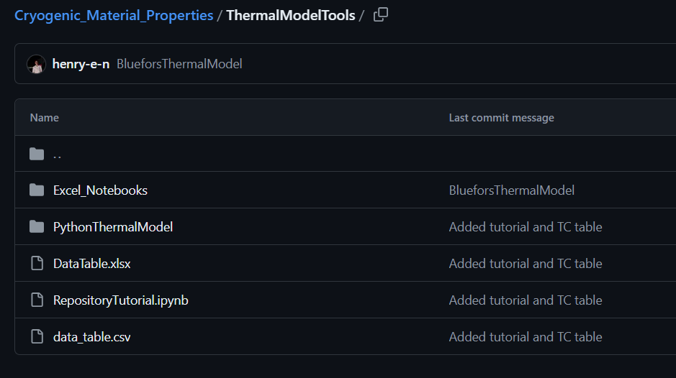
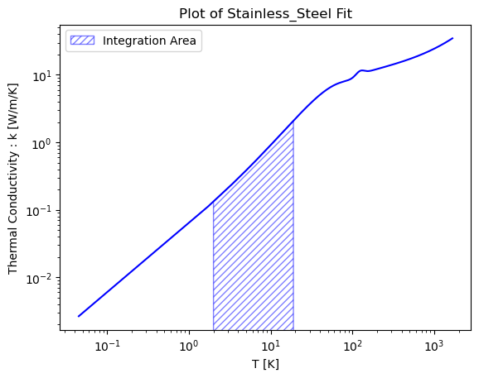
Tutorial Jupyter Notebook

Slide 11
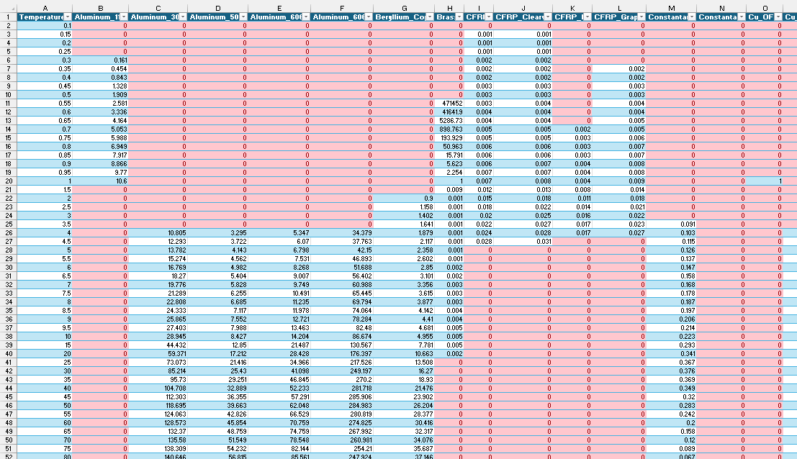
Notice all the red: Red means the repository is missing data (or has insufficient data) within that temperature range.

